Slide 1
DR.SNSRCAS, CBE
SUBJECT: CLOUD TECHNOLOGY FUNDAMENTALS
COURSE CODE:21UCA501 UNIT - IV
TITLE: Defining the Windows Azure Platform
YEAR: III SEMESTER 2022-2023 (ODD)

Slide 2
Defining the Windows Azure Platform
Azure is Microsoft’s Infrastructure as a Service (IaaS) Web hosting service. Azure is a deep blue color, the color of the clear sky onto which you can paint clouds.

Slide 3
Defining the Windows Azure Platform
A developer creates an Azure application by first logging onto the Azure portal from the Sign
supplying a Windows Live ID, creating a hosted account, and provisioning a storage account. The completed application can then be made available to users as a hosted application or service. up now button.

Slide 4
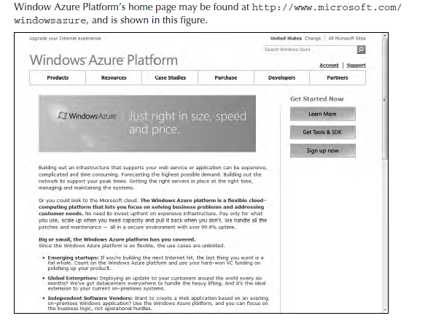
Defining the Windows Azure Platform

Slide 5
Choosing a Database for AWS
In choosing a database solution for your AWS solutions, consider the following factors in making your selection:
Choose Simple DB when index and query functions do not require relational database support.
Use Simple DB for the lowest administrative overhead.

Slide 6
Choosing a Database for AWS
Select SimpleDB if you want a solution that autoscales on demand.
Choose SimpleDB for a solution that has a very high availability.

Slide 7
Choosing a Database for AWS
Use RDS when you have an existing MySQL database that could be ported and you want to minimize the amount of infrastructure and administrative management required.

Slide 8
Choosing a Database for AWS
Use RDS when your database queries require relation between data objects.
Chose RDS when you want a database that scales based on an API call and has a pay-as-you- use-it pricing model.

Slide 9
Amazon Relational Database Service (RDS) Amazon Relational Database Service is a variant of the MySQL5.1 database system, but one that is somewhat simplified

Slide 10
Amazon Relational Database Service (RDS) RDS automatically performs functions such as backups and is deployable throughout AWS zones using the AWS infrastructure.

Slide 11
Amazon Relational Database Service (RDS) In RDS, you start by launching a database instance in the AWS Management Console and assigning
the DB Instance class and size of the
data store.

Slide 12
Amazon Relational Database Service (RDS) The DB Instance is then connected to your MySQL database.
Any database tool that works with MySQL 5.1 will work with RDS. Additionally, you can monitor your database usage as part of Amazon CloudWatch.

Slide 13
Amazon Relational Database Service (RDS) Pricing is based on machine hour rates by class, by amount of storage per month, and per million requests.

Slide 14
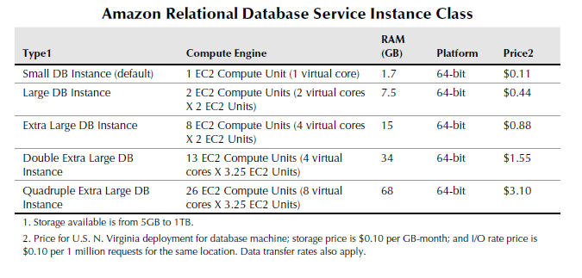
Amazon Relational Database Service (RDS)

Slide 15
Amazon Relational Database Service (RDS) Among the important features of RDS is the automated point-in-time backup system for data in the database as well as for the MySQL transaction logs. Backups can be saved for up to eight days. In
addition to backup, RDS supports database snapshots.

Slide 16
Amazon Relational Database Service (RDS) A DB Snapshot is stored as a full database backup and is retained until you specifically delete it from your storage container. Snapshots may be scheduled or may be manually initiated by an administrator.

Slide 17
Amazon Relational Database Service (RDS) A DB Snapshot is stored as a full database backup and is retained until you specifically delete it from your storage container. Snapshots may be scheduled or may be manually initiated by an administrator.

Slide 18
Amazon Relational Database Service (RDS) The deployment of RDS databases can be spread among multiple availability zones for increased fault tolerance and data availability.

Slide 19
Amazon Relational Database Service (RDS) The deployment of RDS databases can be spread among multiple availability zones for increased fault tolerance and data availability.

Slide 20
User authentication
OpenID is a developing industry standard for authenticating “end users” by storing their digital identity in a common format.
When an identity is created in an OpenID system, that information is stored in the system of any OpenID service provider and translated into a unique identifier.

Slide 21
User authentication
OpenID is a developing industry standard for authenticating “end users” by storing their digital identity in a common format.
When an identity is created in an OpenID system, that information is stored in the system of any OpenID service provider and translated into a unique identifier.

Slide 22
User authentication
Identifiers take the form of a Uniform Resource Locator (URL) or as an Extensible Resource Identifier (XRI) that is authenticated by that OpenID service provider.

Slide 23
User authentication
Any software application that complies with the standard accepts an OpenID that is authenticated by a trusted provider.
A very impressive group of cloud computing vendors serve as identity providers (or OpenID providers), including AOL, Facebook, Google, IBM, Microsoft, MySpace, Orange, PayPal, VeriSign, Live Journal, Ustream, Yahoo!, and others.

Slide 24
User authentication
Any software application that complies with the standard accepts an OpenID that is authenticated by a trusted provider.
A very impressive group of cloud computing vendors serve as identity providers (or OpenID providers), including AOL, Facebook, Google, IBM, Microsoft, MySpace, Orange, PayPal, VeriSign, Live Journal, Ustream, Yahoo!, and others.

Slide 25
User authentication
The OpenID standard applies to the unique identity of the URL; it is up to the service provider to store the information and specify the forms of authentication required to successfully log onto the system.

Slide 26
User authentication
Thus an OpenID authorization can include not only passwords, but smart cards, hardware keys, tokens, and biometrics as well. OpenID is supported by the OpenID Foundation (http:// openid.net/foundation/)

Slide 27
User authenticationThese are samples of trusted providers and their URL formats:
l Blogger: <username>.blogger.com or <blogid>.blogspot.com
l MySpace: myspace.com/<username>
l Google: https://www.google.com/accounts/o8/id
l Google Profile: google.com/profiles/<username>
l Microsoft: accountservices.passport.net/
l MyOpenID: <username>.myopenid.com
l Orange: openid.orange.fr/username or simply orange.fr/
l Verisign: <username>.pip.verisinglabs.com
l WordPress: <username>.wordpress.com
l Yahoo!: openid.yahoo.com

Slide 28
User authentication
After you have logged onto a trusted provider, that logon may provide you access to other Web sites that support OpenID. When you request access to a site through your browser (or another application that is referred to as a user-agent), that site serves as the “relying party” and requests of the server or server-agent that it verify the end-user’s identifier.

Slide 29
User authentication
After you have logged onto a trusted provider, that logon may provide you access to other Web sites that support OpenID. When you request access to a site through your browser (or another application that is referred to as a user-agent), that site serves as the “relying party” and requests of the server or server-agent that it verify the end-user’s identifier.

Slide 30
Thank You

